Slide 1
Statsbomb Data
SHU-Rouen Winter School

Slide 2
Statsbomb
https://statsbomb.com
https://statsbomb.com/what-we-do/hub/free-data/
http://statsbomb.com/wp-content/uploads/2019/12/Using-StatsBomb-Data-In-R.pdf
Notes:
https://statsbomb.com
https://statsbomb.com/what-we-do/hub/free-data/
http://statsbomb.com/wp-content/uploads/2019/12/Using-StatsBomb-Data-In-R.pdf

Slide 3
StatsBomb and R
https://posit.co/download/rstudio-desktop/
https://posit.cloud/plans/free

Slide 4
Datasets

Slide 5
Datasets

Slide 6
Datasets

Slide 7
Importing Data

Slide 8
Importing Data
df_matches = this imports data relating to each match in the dataset
df_events = this imports data relating to events in the dataset
*naming convention- df = dataframe

Slide 9
Importing Data

Slide 10
Importing Data

Slide 11
Importing Data

Slide 12
Importing Data

Slide 13
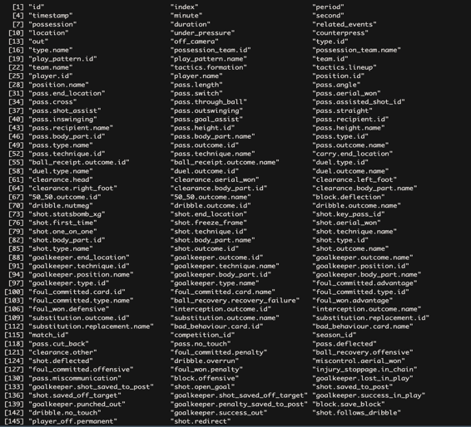
Raw Event Data
146 Variables

Slide 14
StatsBombR: Function: allclean

Slide 15
StatsBombR: Function: allclean

Slide 16
Clean: Events
183 Variables

Slide 17
CSV Files

Slide 18
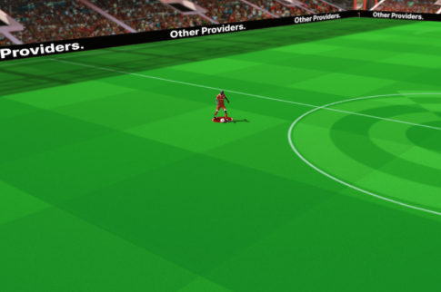
StatsBomb: Competitors

Slide 19
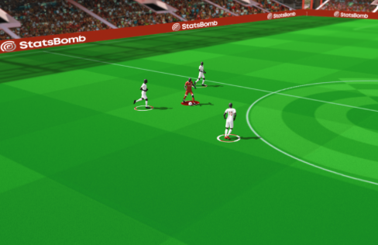
StatsBomb Event Data

Slide 20
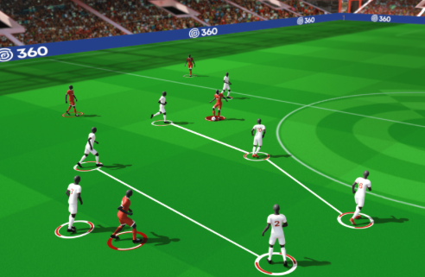
StatsBomb 360

Slide 21
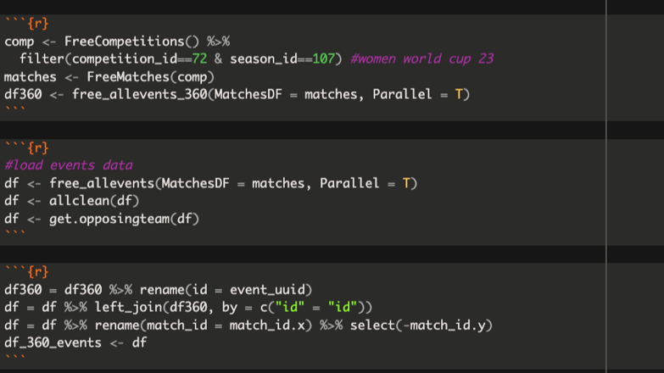
360 Dataset

Slide 22
Data Example

Slide 23
World Cup 2023-Corners
602 corners
274 (64%) of corners resulted in a shot
Total of 327 shots from corner possession
28 (17%) of the total 164 goals scored in the world cup were from corners
4.6% chance of scoring from a corner

Slide 24
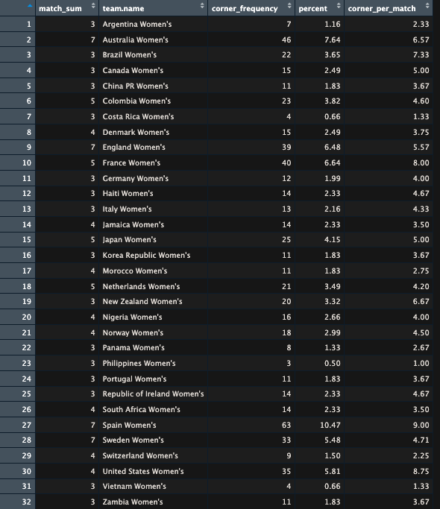
Corner Summary
df events
&
df matches

Slide 25
Corner Summary
Spain
highest percentage: 10.47%
highest corner_per_match: 9.00
USA
2nd highest corner_per_match: 8.75

Slide 26
USA: Example

Slide 27
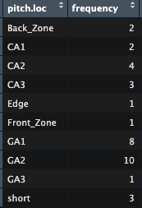
USA: 35 Corner
Left sided corner
3
8
10
1
2
1
2
4
3
Attacking direction
1
Left sided corner
8.6%
22.9%
28.6%
2.9%
5.7%
2.9%
5.7%
11.4%
8.6%
Attacking direction
2.9%

Slide 28
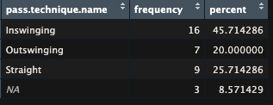
Technique
Short/indirect

Slide 29
Technique and Location

Slide 30
Technique and Location
Inswing
Outswing
8
4
1
2
1
1
1
3
1
Attacking direction
1
Straight
Short
4
3
2
1
2
Attacking direction

Slide 31
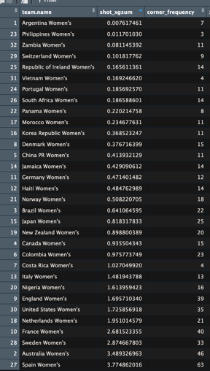
xG from Corners

Slide 32
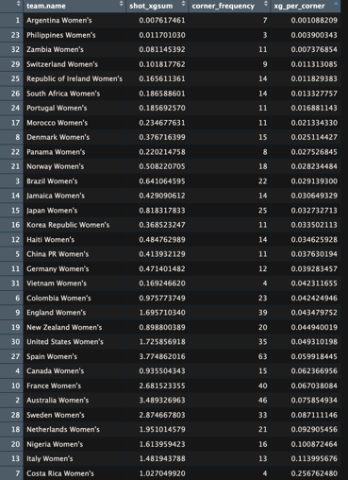
xG from Corners

Slide 33
USA: Shots from Corners
22 shots
From 21 corners
Left sided corner
2
5
4
1
1
1
1
3
2
Attacking direction
1

Slide 34
USA Shots

Slide 35
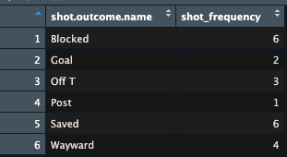
Shot Outcome Corners

Slide 36
Corner Outcome

Slide 37
Goals from Corners

Slide 38
Goals
Half-Volley
Left Foot
Open Play
Head
Open Play

Slide 39
Goal- 360 Data

Slide 40
Goal- Adding Further Context

Slide 41
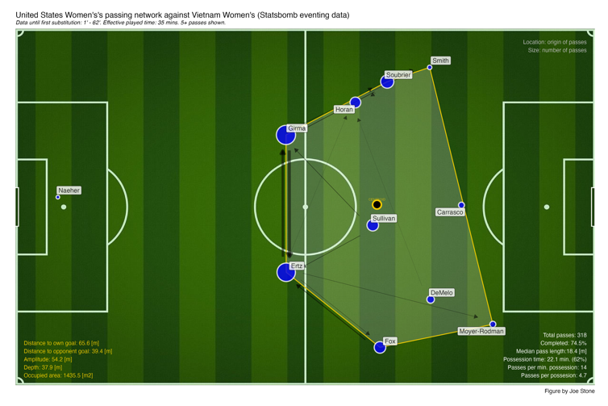
Passing Networks

Slide 42
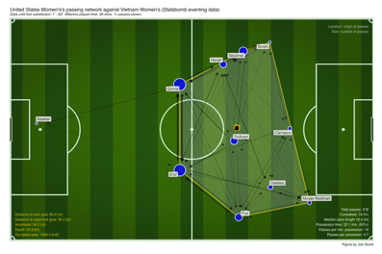
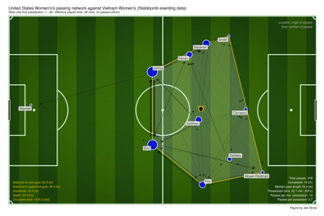
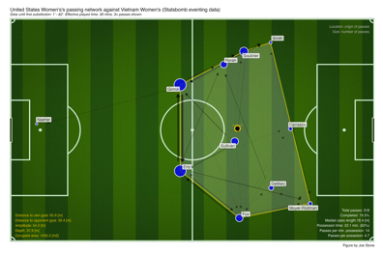
Passing Network- Min Pass

Slide 43
Passing Networks

Slide 44
Passing Networks

Slide 45
Passing Networks

Slide 46
Passing Networks

Slide 47
Examples
http://statsbomb.com/wpcontent/uploads/2019/12/Using-StatsBomb-Data-In-R.pdf
https://statsbomb.com/articles/soccer/statsbomb-360-analysing-the-best-corner-teams-in-europe/

